Slide 1



FIFA INSIGHT CREW
ALY 6015 - INTERMEDIATE ANALYTICS
TEAM MEMBERS: SANKALP SUSIL KUMAR BISWAL, SANCHI GUPTA,
SHARANYA BADRINARAYANAN, RATNESH MISHRA, RHEA JOHN THOPPIL
INSTRUCTOR: VLADIMIR SHAPIRO, NORTHEASTERN UNIVERSITY

Slide 2
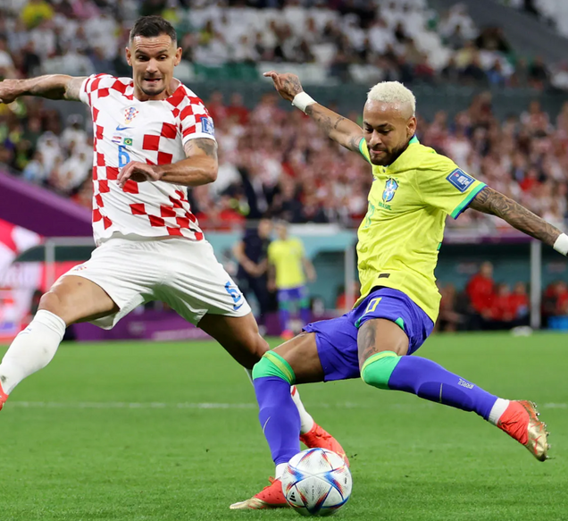

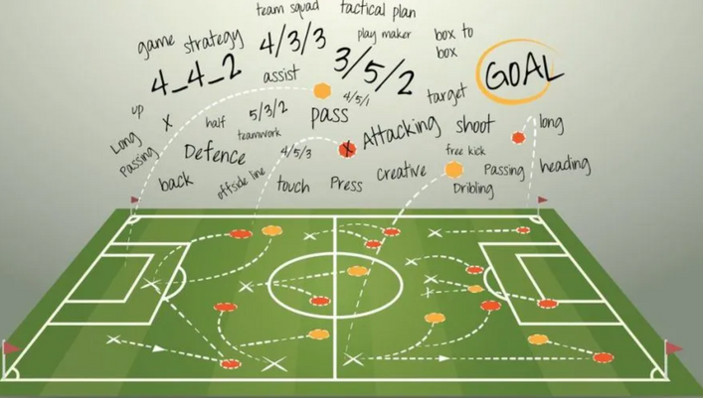

WELCOME TO OUR ANALYSIS JOURNEY
Our project delves deep into the world of football analytics, examining key player attributes to uncover what drives performance and market value in the professional football landscape.
Predicting overall performance ratings from key attributes.
Classifying players into their club positions based on performance metrics.
Examining the relationship between age and pace.
Forecasting market value using player statistics and attributes.
Navigating Through Our Goals

Slide 3

ANALYSIS & VISUALISATIONS
To tackle our data, we preprocessed the data and performed separate EDAs for each question. We have used EDA techniques like correlation matrix, boxplot, scatterplot, etc.

Slide 4
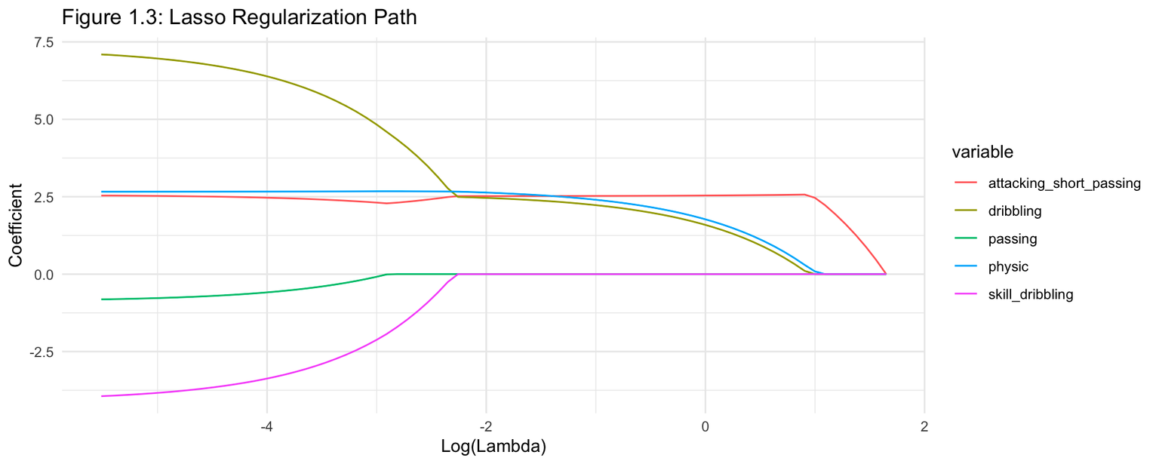
Predict the Overall Performance Rating of football players
based on key performance attributes.
#1
METHOD USED
Predictive Modeling with Multiple Regression
Features Selected
Attack short passing,
Dribbling, Passing,
Physic and Skill dribbling
OBSERVATION
As log(lambda) increases, the model becomes more regularized.
Features with less impact on the target outcome (e.g., those with small coefficients) are effectively “shrunk” toward zero.
Lasso helps select relevant features and simplifies the model.

Slide 5
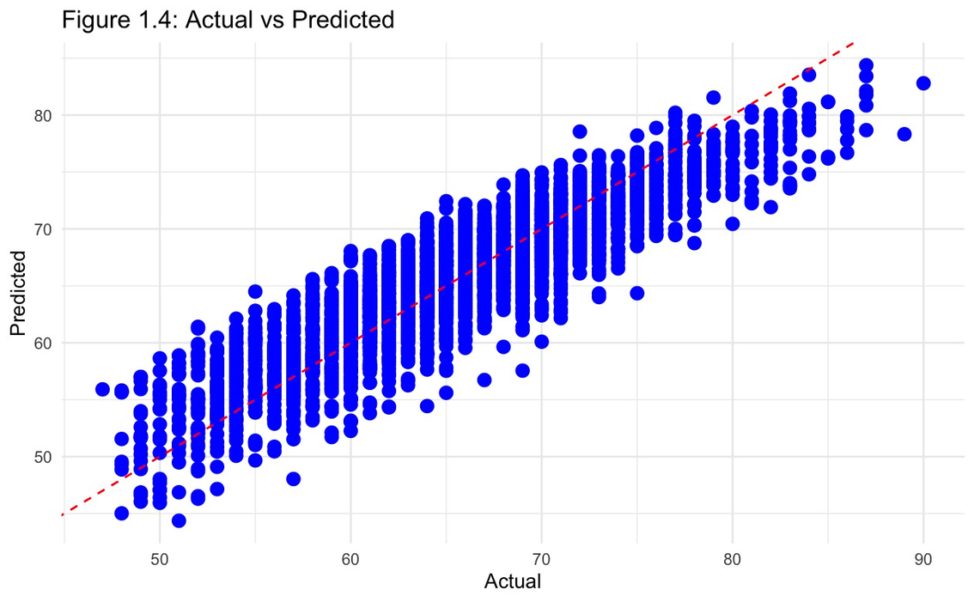
Predict the Overall Performance Rating of football players
based on key performance attributes.
#1
OBSERVATION
The blue dots should cluster closely around the red dashed line and this alignment signifies a good fit between actual and predicted values.
Points far from the line (either left or right) exert more influence on the fitted line. These outliers can pull the line toward them.
Model Evaluation

Slide 6
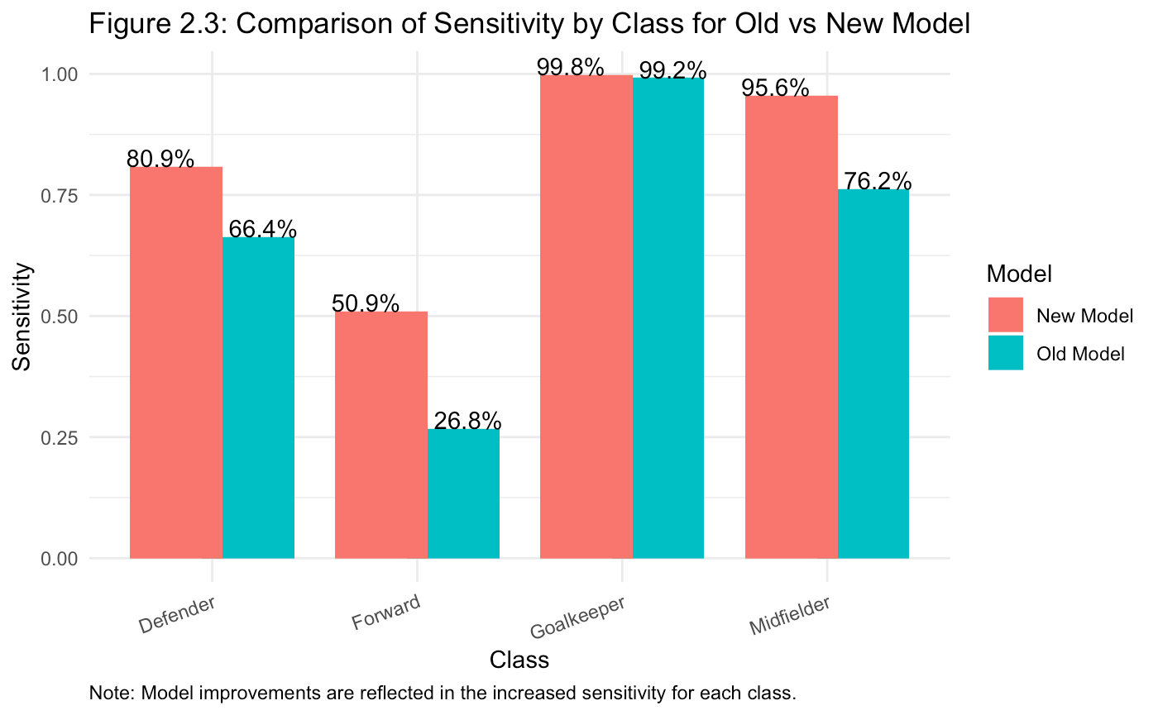
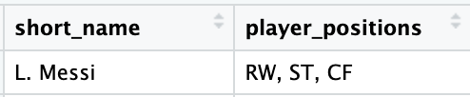
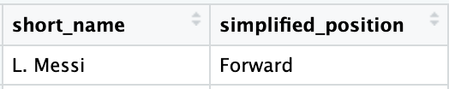
Classify a player as Goalkeeper, Defender, Midfielder or Forward based on their individual performance attributes such as pace, shooting, passing, dribbling, defending, physic, overall, potential.
#2
Features Engineering
METHOD USED
Predictive Modeling
with Classification
using
BAGGED KKN

Slide 7
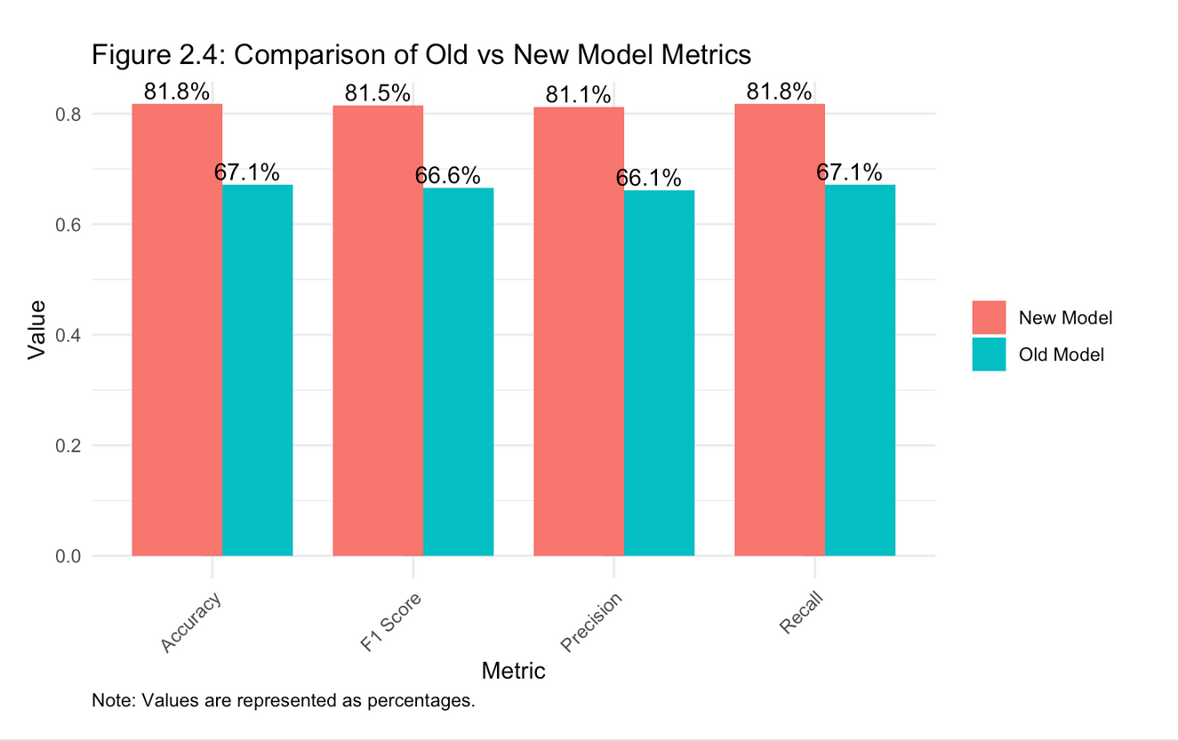
Classify a player as Goalkeeper, Defender, Midfielder or Forward based on their individual performance attributes such as pace, shooting, passing, dribbling, defending, physic, overall, potential.
#2
OBSERVATION
The new model has shown marginal improvements across all metrics compared to the old model, indicating it is slightly better at correctly classifying cases, particularly in terms of reducing false positives and false negatives.

Slide 8
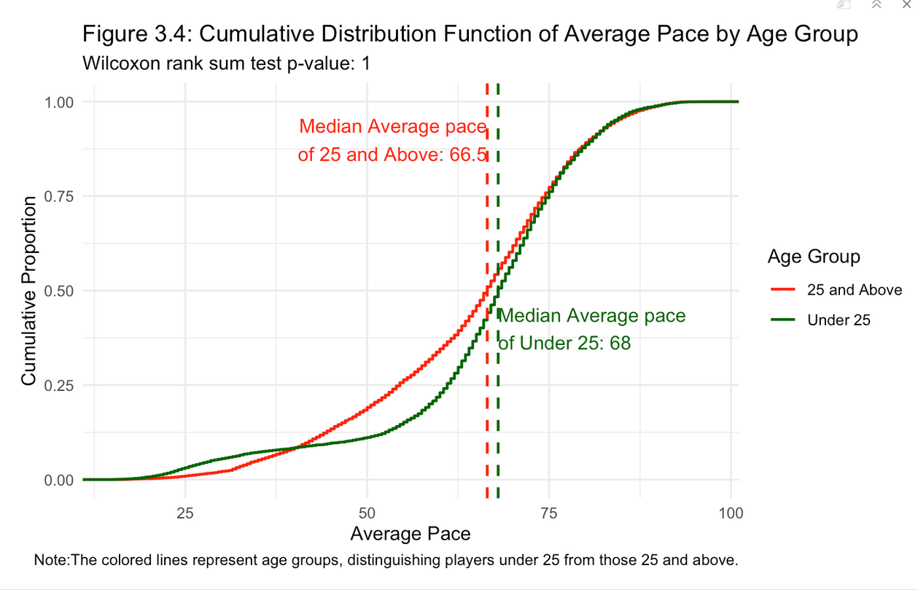
Test, whether a player's age affect their average pace (a combination of acceleration and sprint speed).
#3
Null Hypothesis(H0) = The median average pace of players under 25 is less than or equal to the median average pace of players 25 and above.
Alternative Hypothesis(H1) = The median average pace of players under 25 is greater than the median average pace of players 25 and above.
METHOD USED
Hypothesis Testing using Wilcoxon rank sum test
OBSERVATION
We fail to reject the null hypothesis at alpha=0.05.
While the younger group has a slightly higher median pace, the Wilcoxon test indicates that this difference is not statistically significant.

Slide 9
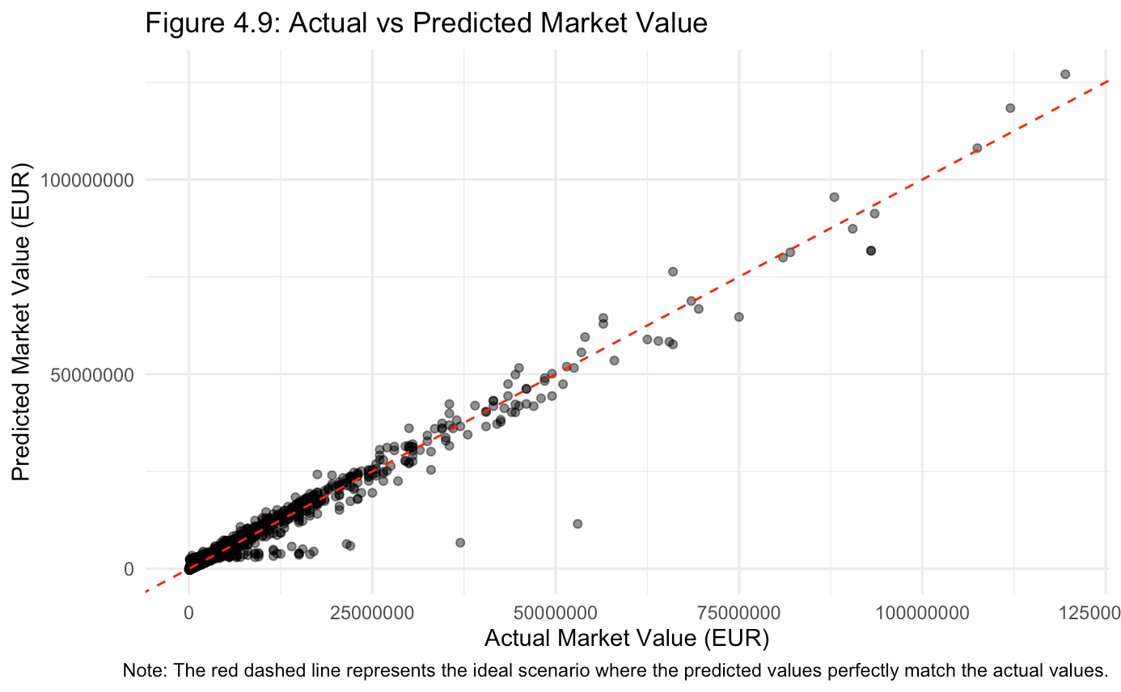
Predict a player's market value based on attributes such as age, overall rating, potential, and specific skill attributes (passing, dribbling, shooting) and other variables.
#4
METHOD USED:
Predictive Modeling with Linear Regression
OBSERVATION
The black dots should cluster closely around the red dashed line and this alignment signifies a good fit between actual and predicted values.
Points far from the line (either left or right) exert more influence on the fitted line. These outliers can pull the line toward them.

Slide 10






FINDINGS & CONCLUSION
Finding n° 1
Finding n° 3
Finding n° 2
Finding n° 4
Lasso regularization helps in identifying and prioritizing key attributes, allowing an understanding of factors influencing player ratings. The MSE evaluation provides a comprehensive assessment of the model's predictive accuracy and potential areas for improvement.
Wilcoxon rank sum test indicates no significant difference in average pace between players under 25 and those 25 and above, despite visual difference. Age, therefore, does not seem to be a predictor of average pace in this dataset.
The linear regression model, with a high R-squared value, indicates a strong predictive capability, identifying key player attributes that correlate with market value. Release clause, wages, and international reputation are the strongest predictors, signifying that market value isn't just about player performance stats but also contractual and reputation factors.
KKN Model has a good accuracy & is good at predicting Goalkeepers. The model seems to be moderately reliable, but improvements could be made, especially in predicting Forward and Midfielder positions, which have lower sensitivity.

Slide 11
REFERENCES
A host of comprehensive sports datasets for research, analysis, data modeling, data-visualization, predictions, machine-learning ETC. Sports. (n.d.). <https://sports-statistics.com/sports-data/sports-data-sets-for-data-modeling-visualization-predictions-machine-learning/>
Developing research questions. Library. (2023, March 3). <https://www.monash.edu/library/help/assignments-research/developing-research-questions>
OpenAI. (2021). ChatGPT (Version 3.5). OpenAI.https://chat.openai.com/
Lasso Regression in R Programming. (2023, December 19). GeeksforGeeks. https://www.geeksforgeeks.org/lasso-regression-in-r-programming/
Brownlee, J. (2019, August 22). Feature Selection with the Caret R Package. MachineLearningMastery.com. https://machinelearningmastery.com/feature-selection-with-the-caret-r-package/
How to Plot Predicted Values in R. (2021, December 19). GeeksforGeeks. https://www.geeksforgeeks.org/how-to-plot-predicted-values-in-r/
Stepwise regression. (2024, January 21). Wikipedia. https://en.wikipedia.org/wiki/Stepwise_regression

